Slide 1

Summarization of Online Text Reviews
By…
Kishor (np689)
Likhil (lkr46)
Shabrin (st3236)
Vuthej (vv334)

Slide 2

Objective
Problem Will we be reading thousands of reviews?
To build a crisp summary of thousands of user reviews of a product without loosing relevancy.
(Saves the user the time needed to invest in reading all the reviews)

Slide 3
Overview
Dataset Source (Built in DSCI-511 using web-scraping)
Focused on Phone Reviews
EDA
Unsupervised Learning
LDA Model (Latent Dirichlet Allocation)
Inclusion of Bigrams and Trigrams
Summarizing reviews to topic from LDA

Slide 4
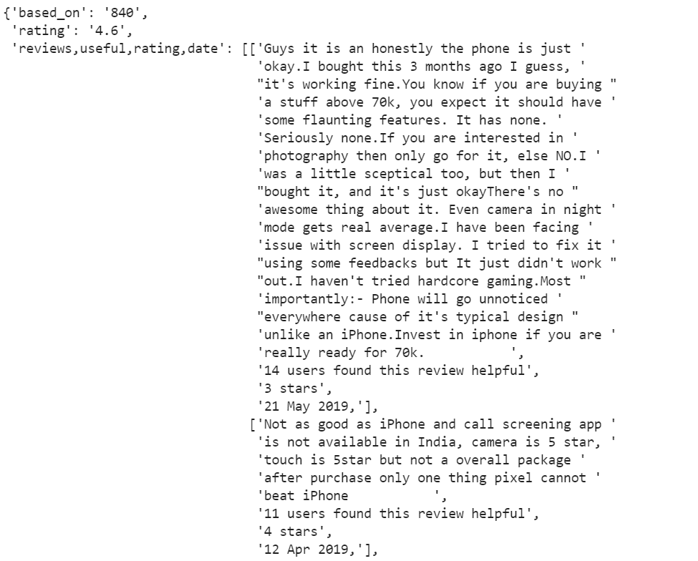
Data Overview
JSON Format Data
Current data has reviews for 11 different mobiles with over 10,000 reviews in total.

Slide 5
Pre-processing of Data
Reviews include special characters.
Understanding the sentiment of Emojis is tough as they can be sarcastic too.
Sorting the reviews based on the date of entry/submission.
Converting the data type in columns
‘Users found Useful’ – From String to Integer
‘User Rating’ – From String to Integer
‘Review Date’ – From String to Datetime object

Slide 6
Approach to Sentiment Analysis
Cleaning of data
Feature Selection
Tokenization
Removal of stop words, contractions
Stemming and Lemmatization
Bag of Words Vectorizer
TF-IDF for Vectorizer
Vectorized feed LDA
NLTK Sentiment Vader for building the Polarity
Applying Bi-grams and Tri-grams
Summarizing reviews to topic from LDA
Positive
Negative

Slide 7
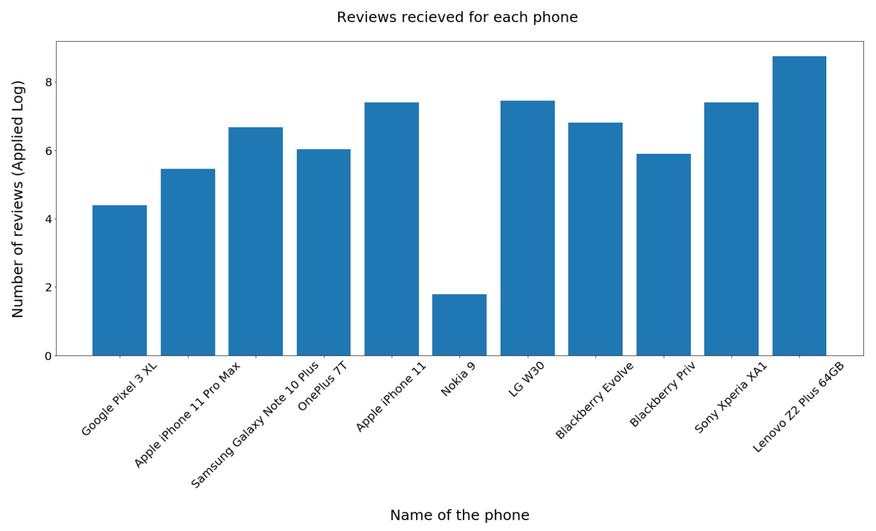

Slide 8
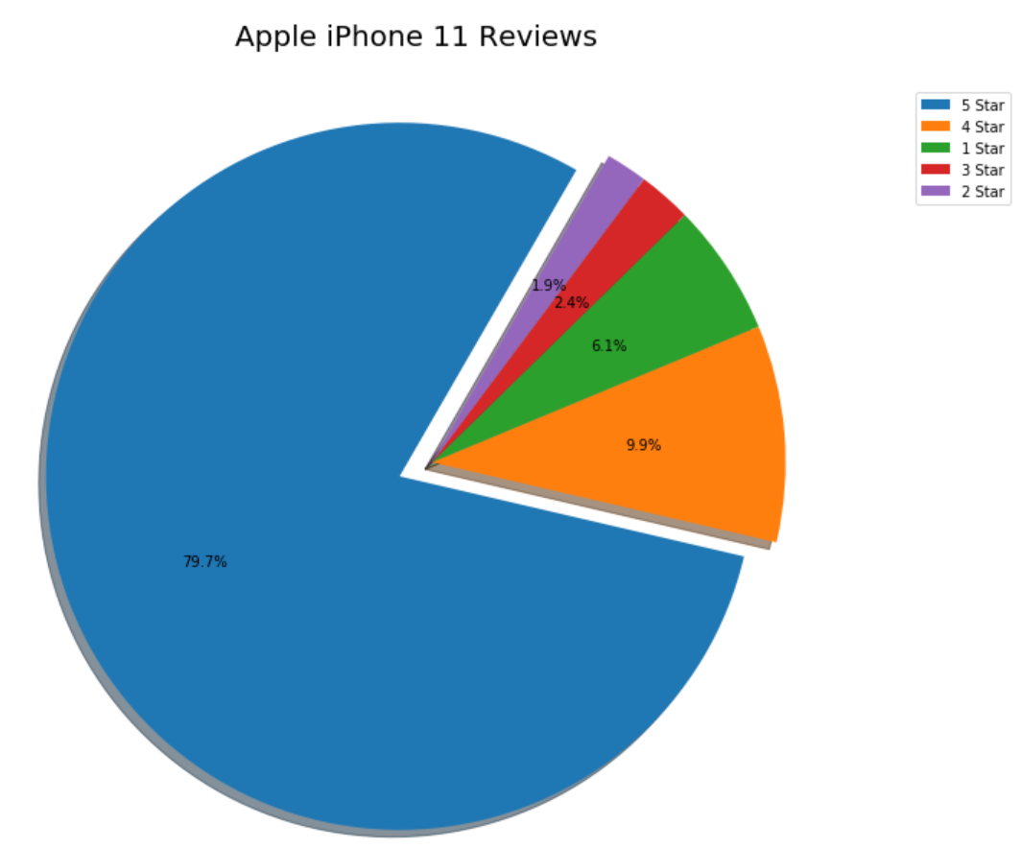
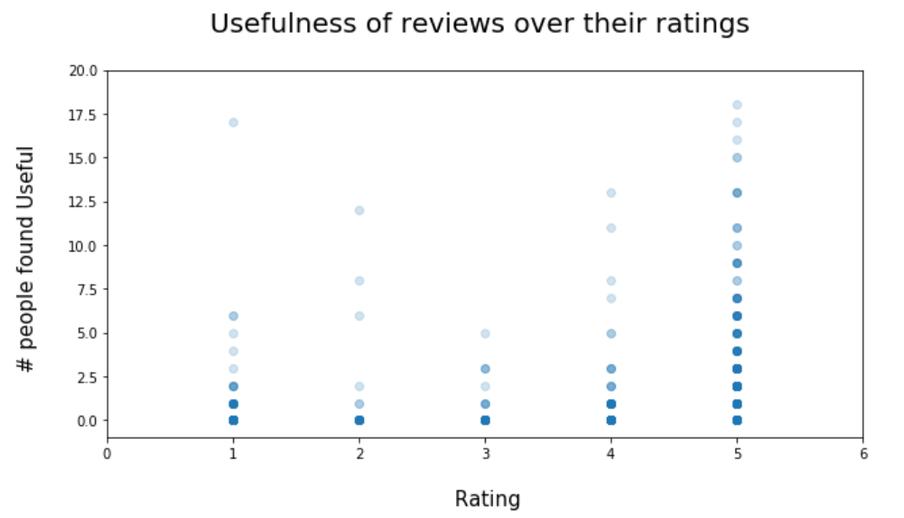

Slide 9
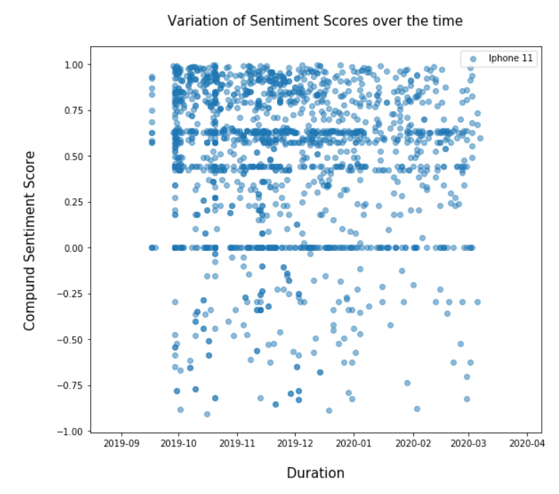
Feature Polarity?

Slide 10
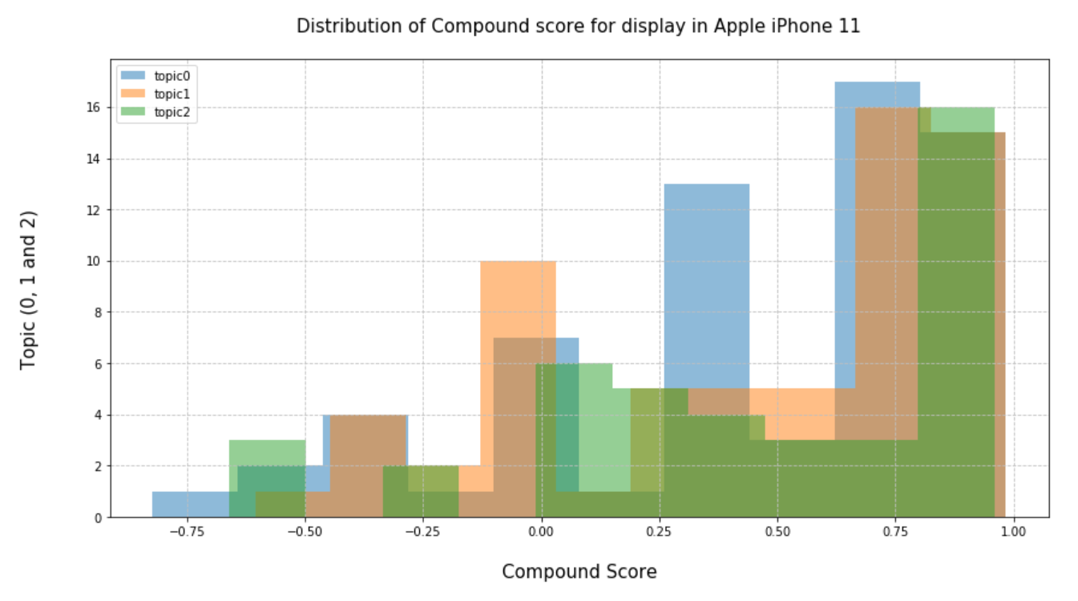

Slide 11
Challenges Faced
Not all reviews were in plain English
Presence of slang words and emoticons
LDA provides Topic with single word and score.
Bigrams, Trigrams provided pairs of two and three words with scores.
For Tri-gram to work, review should at least have 3 words. Some instances had just two words.
Identifying Opinion spam is difficult since input data set lacks required labels.

Slide 12
Application this fits into..
All e-commerce systems which has numerous user reviews.
Companies can understand the trend in public for their products.
Social Networking sites can use this to identify polarities in tweets/posts about any popular topic.

Slide 13
Future Work
Gathering more data probably with labels so that we can turn this into a supervised learning model.
Including emoticons and image processing as some users provide reviews with emojis and pictures.

Slide 14
Thank You!

